Slide 1

ONLINE
TEST

Slide 2
LANGUAGE
USED

Slide 3



JAVA IS A :
Simple
Object-oriented
Interpreted
Secure
Portable
Platform Independent

Slide 4

This concept of online test fulfils the following requirements:
It provides a less expensive as well as an effective method of performing examinations.
It provides best facilities for the students to answer the question only with a single click.
It saves time as well as money.
It lessens the student’s and teacher’s frustration.

Slide 5

ONLINE TEST
MARKS GENERATED
CANDIDATE
PERCENTAGE
RESULT

Slide 6
E-R DIAGRAM
GIVES
CANDIDATE
ONLINE TEST
QUESTIONS
%AGE
NAME
INSTRUCTIONS
MARKS

Slide 7
   Start
Enter user name
FLOW
CHART
No
Proceed?
Press cancel
Yes
     Press OK
Window
displayed
Click Start to
     Run the test
If Questions answered in given time?
NO
Timer
  over  
Ye
Click Finish to
Check result
End

Slide 8
HOW TO EXECUTE
A PROGRAM
IN JAVA

Slide 9
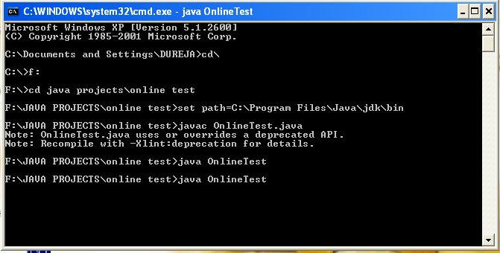

Slide 10
WORKING
OF
PROJECT

Slide 11
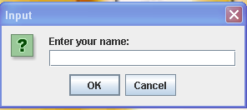

Slide 12
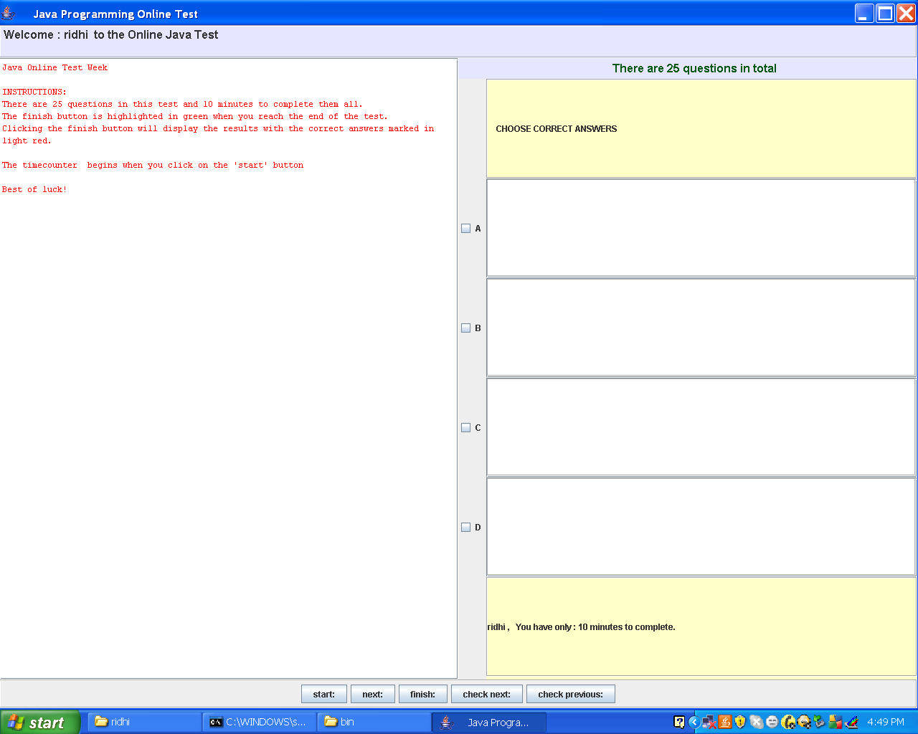


Slide 13
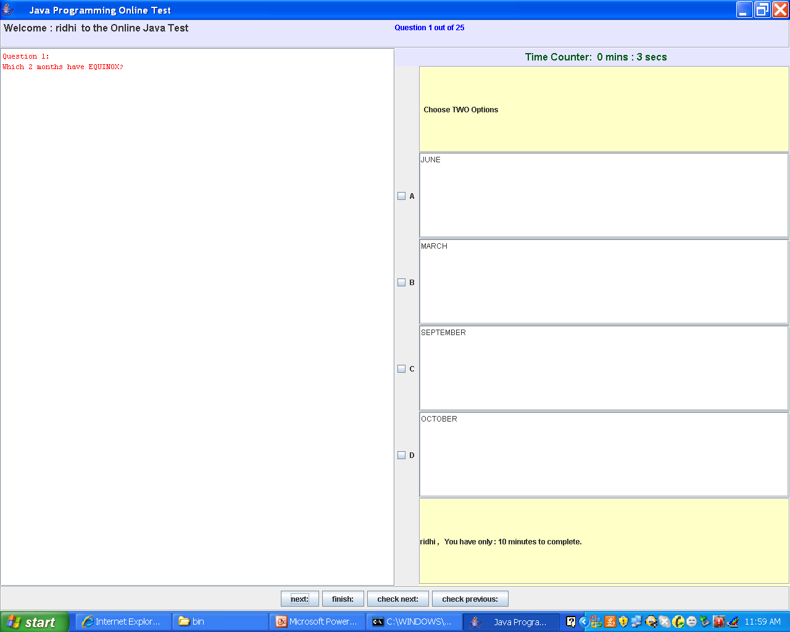

Slide 14
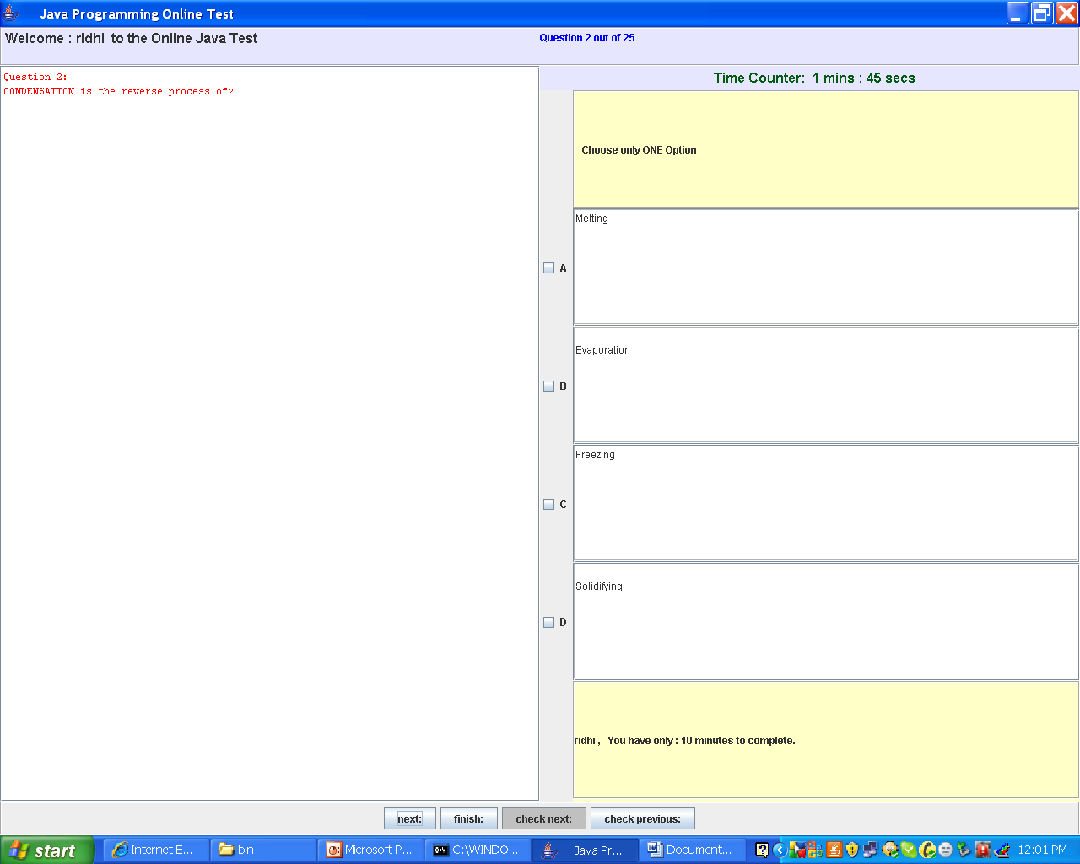

Slide 15
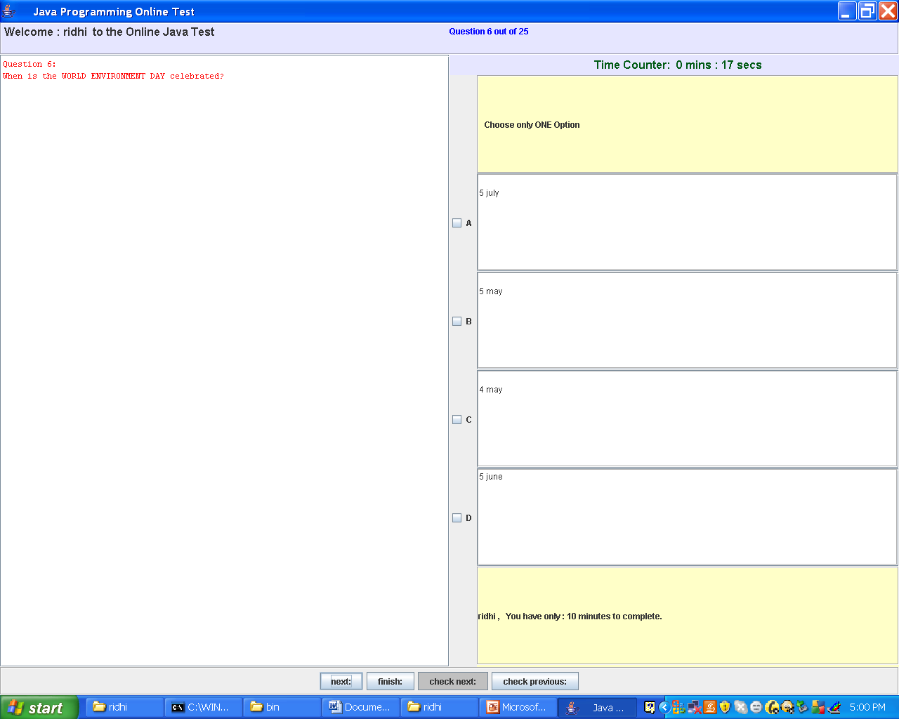

Slide 16
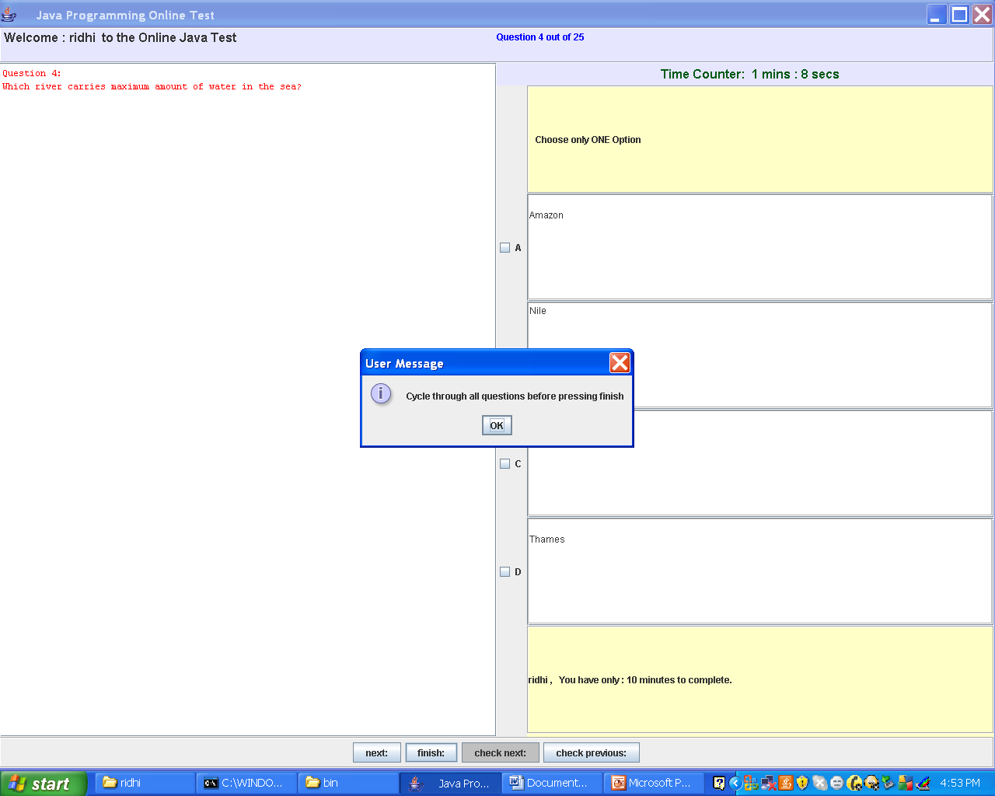

Slide 17
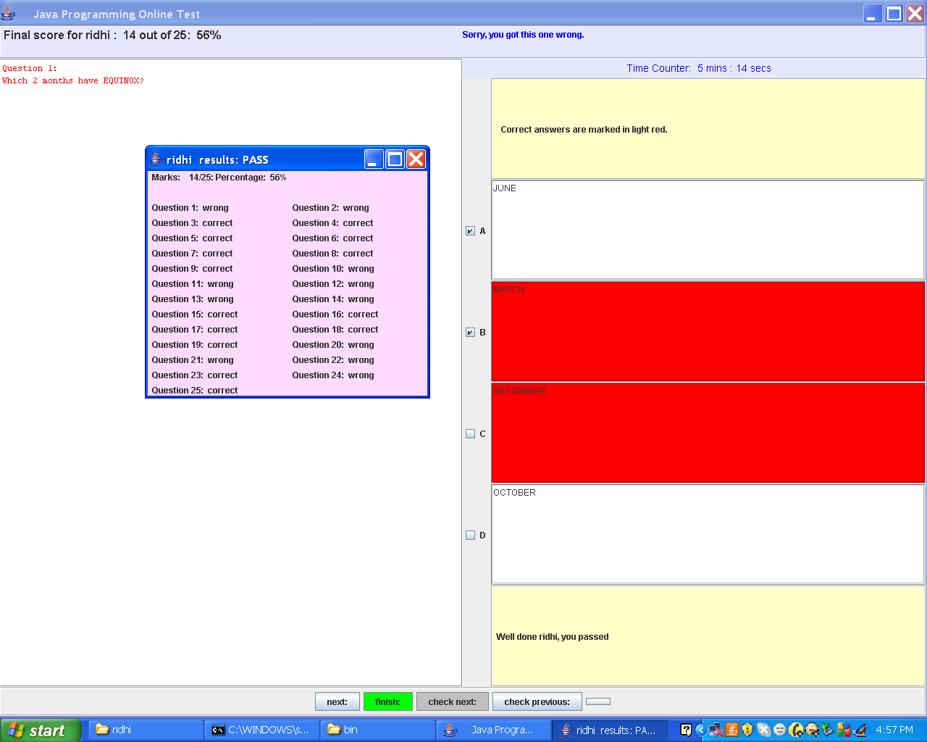

Slide 18

Across the globe: This project finds it application in conducting examination over the globe.
Student’s needs: It saves time as well as money. It lessens student’s frustration

Slide 19

It provides an efficient and reliable platform to work upon.
It saves time and is thus a faster means of examination.
It is less costly than the other means of examination

Slide 20

Since this software is designed in java, it is Platform independent..
Successfully handles the problem.
Reliability gives consistent results.
System is robust.

Slide 21

All the questions have to be scrolled once before clicking the finish button
A user must have fundamental knowledge as to how to use the application

Slide 22

Every type of exam can be conducted online and it will lessen the teacher’s frustration.
We can also conduct tests for various subjects.
Tests can also be conducted for various difficulty levels.
We can provide limited access by giving passwords for users.

Slide 23

. Conducting online test is a step to ease the current structure of examination. This way of conducting test on one of the most secure operating system and with highly sophisticated technology is cost effective and save time too.
This way of conducting test not only save time but also lessens student’s and teacher’s frustration. It is an easier way of giving examination, any person across the globe can appear for the examination.

Slide 24
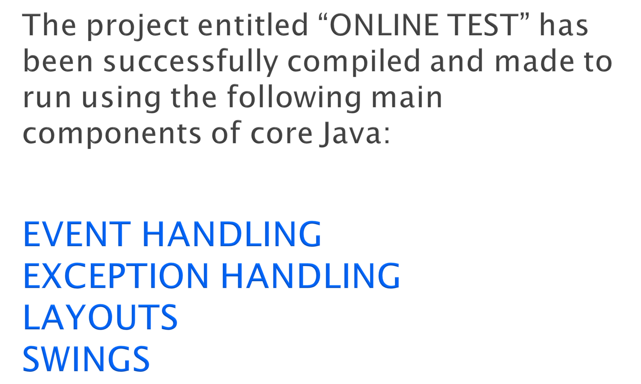

Slide 25
THANK
YOU

